Slide 1
T
INFO 3135
Linear lists

Slide 2
Linear Lists
Lists are one of the most common data structures for storing information.
A list of game scores, or a player’s items that they have in their inventory.
A list of patients in a hospital who are waiting to been seen.
We can also to refer to lists as collections.
A simple list can be represented by an array of primitive data types.
An array is a linear list.

Slide 3
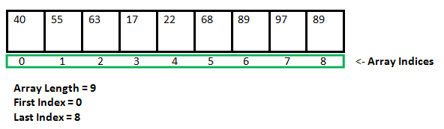
Arrays as Lists
Arrays as lists
Arrays generally use contiguous memory
Arrays are usually homogenous
Operations on arrays are limited to its structure
Arrays can be used to implement different types of lists

Slide 4
List Operations
What operations do we need to perform on our list?
Insert – add a value to the list
Delete – remove a value from the list
Update – change a value in the list
Read – read a value from the list
These are the basic CRUD operations
Search – find a value in a certain location
Reorder – sort the list by certain criteria
Resize – make the list bigger or smaller depending on our needs
Rules – depending on the type of list we need there may be rules surrounding the operations

Slide 5
Stacks
A stack is a structure that uses the LIFO approach ( Last in, First out)
A new element can only be added “pushed” onto the “Top” of the stack
An element can only be removed “popped” from the “Top” of the stack
Additionally, a “peek” operation may give access to the top without modifying the stack
If the stack is full and does not contain enough space to accept a new value to be pushed onto the stack is then considered to be in an “overflow” state.
We can an operation to check if the stack is full before we push a new value.

Slide 6
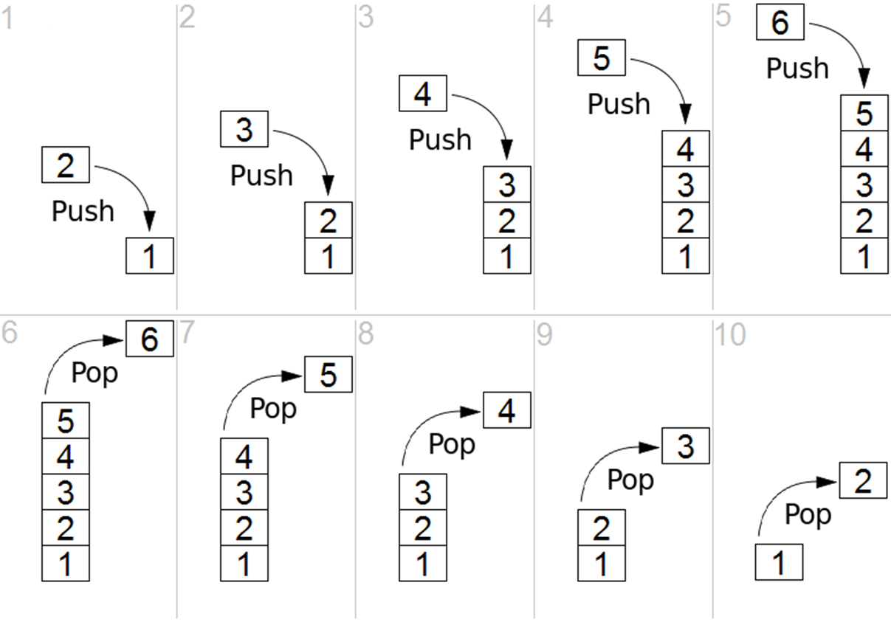
Stack Operations
Push() – add an element to the top of the stack
Pop() – remove an element from the top of the stack
Peek() – look at the value of the top of the stack
isFull() – check if the stack is in overflow

Slide 7
Use of stacks
Stacks have several different applications in software development
An "undo" mechanism in an application, this operation is accomplished by keeping all changes in a stack.
A compiler's syntax check for matching braces is implemented by using stack
Back/Forward stacks on browsers
Game development – “Backtracking” for example
Find your way through a maze.
Find a path from one point in a graph (roadmap) to another point.
Play a game in which there are moves to be made (checkers, chess)

Slide 8
Stack as an Array
Using an array to implement a stack gives us a (bounded) array.
An array uses a defined size created in contiguous memory
We are constrained to the size (number of elements) of the array definition.
If we wish to have a different sized stack we need to create another array that is larger (or smaller) and copy the contents over to the new array.
We can use dynamic arrays to provide this functionality

Slide 9
Stack – an alternative implementation
Arrays are not the only way to implement lists
Linked List
A linked list is a collection of “nodes” that together form a linear ordering.
Each node stores a pointer, called next, to the next node of the list. In addition, each node stores its associated element.
The next pointer inside a node is a link or pointer to the next node of the list.
It does not store any pointer or reference to the previous node
Moving from one node to another by following a next reference is known as link hopping or pointer hopping.
The first and last nodes of a linked list are called the head and tail of the list
The last node in a singly linked list points to nothing

Slide 10
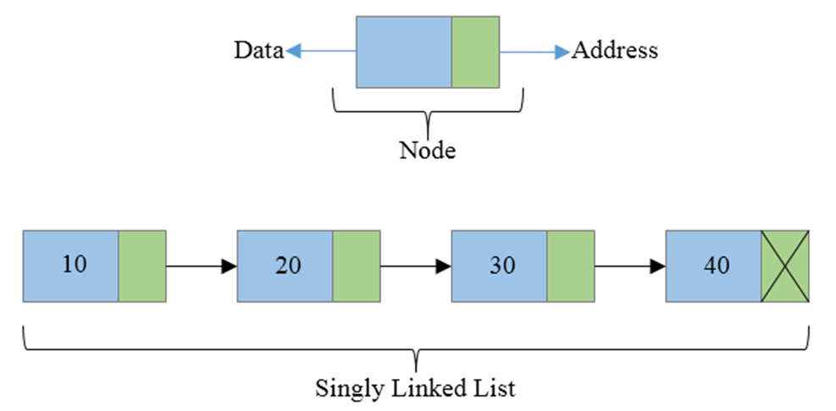
Singly Linked List
A singly linked list can be traversed in one direction. From head to tail
Each “node” contains data which can be a primitive type or a derived type
Each node contains a pointer to the next node. If there is no next node the pointer is set to null
A node will be represented by a C++ class.

Slide 11
Linked List – adding a node
addNode() – add a new node after the current node
Pseudo code
If current pointer to node is null, list is empty
Create a new node using the current point
Set this pointer as the head
Else
If current node’s next pointer is not null
Create a new node using a temporary node pointer
Assign the new node’s next pointer to the current node’s next pointer
Assign the current node’s next pointer to the temporary pointer
Set the temporary node pointer to null
Else
Create a new node using the current node’s next pointer
End if
End if
Set the new node’s value

Slide 12
Linked List – deleting a node
deleteNode() – delete a node
Pseudo code
If current pointer to node is null
No node to delete
Else
If current node’s next pointer is not null
Find the previous node to the current pointer (exercise) how do we do this?
Assign the previous node’s next pointer to the current node’s next pointer
Delete the current node that has now been unlinked
End if
End if
Set the new node’s value

Slide 13
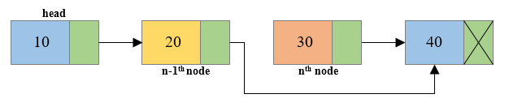
How do we find the previous node?
Exercise
We have a single linked list and we want to delete from somewhere in the middle
We have a pointer to the one we wish to delete
We need to find the previous node.
Write the pseudo code

Slide 14
Let’s Define a Singly Linked List
Let’s write the pseudo code together first.
Describe the structure
The linked list class
The node
Describe the operations
Add node
Delete node from end
Delete node from middle
Traverse the list
There are other operations but we will leave those for now

Slide 15
Now lets Code a Singly Linked List
Using the pseudo code we just created we code the Linked List
We will use this linked list later and we will expand its abilities.

Slide 16
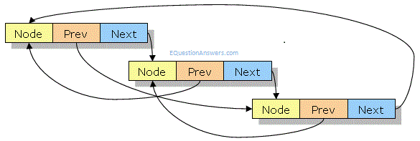
Double Linked List
Removing an element at the middle of a singly linked list is not easy as we need to find the node previous
It is time consuming to remove any node other than the head in a singly linked list – A double link list can help solve this
In addition to its data member, a node in a doubly linked list stores two pointers, a “next” pointer and a “prev” pointer, which point to the next node in the list and the previous node in the list
Now our linked list operations are more flexible and efficient

Slide 17
Queues
A Queue is a list that grows by adding to its tail and shrinks by removing from its head.
Unlike a stack which is a LIFO and operation only take place at the top or one end and queue has operations at both ends.
A queue is a FIFO structure (first in, first out)
Queues are similar to stacks in operation
The follow are queue operations
Clear – clear the queue
Enqueue – add an element to the end (tail)
Dequeue – remove an element from the front (head)
Peek – return the first element without removing it
isEmpty – check if there is anything waiting in the queue

Slide 18
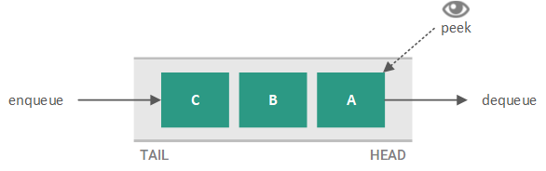
Uses for Queues
Managing transaction requests in a web application
A print queue – documents are handled first come first serve
A keyboard buffer

Slide 19
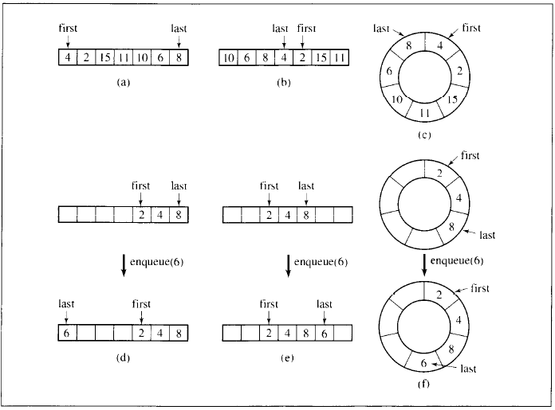
Implementing Queues
Queues can be implemented with arrays or linked lists.
We can use linear lists or circular lists
Generally, a circular queue requires three pointers:
one to the actual buffer in memory
one to point to the start of valid data
one to point to the end of valid data
Arrays are not the most efficient or practical
A doubly linked list would be the best approach

Slide 20
Priority Queues
Sometimes first in/first out scheduling needs to be overruled using some priority criteria
In a sequence p2 may have to be processed before p1.
In priority queues elements are dequeued according to their priority and their position in the queue
The challenge is finding a reasonably efficient algorithm for enqueuing and dequeuing.
We can use a linked list as an entry ordered queue (items are arranged by their entry into the queue) – adding is quick but removing is slower
or we can add elements to the queue based on their priority – removing is quick but adding is slow
Priority must result in a key value that can be sorted

Slide 21
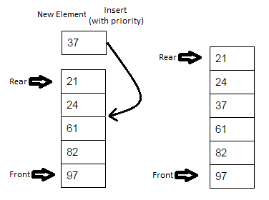
Priority Queue Operations
is_empty - check whether the queue has no elements.
insert_with_priority - add an element to the queue with an associated priority.
pull_highest_priority_element - remove the element from the queue that has the highest priority, and return it.
Peek – view the element with the highest priority but do not remove it

Slide 22
Priority Queues and Queuing theory
Queues are so commonly that a well-developed and mathematical theory of queues exists.
Various scenarios and models are created and analysed.
J.O. Hendriksen (1977 – 1983)
A simple linked list with an additional to the list to find a range of elements in which a new element should be included
Blackstone (1981)
A short ordered list and an unordered list and a threshold priority
Number of elements in the ordered list depend on priority
Some cases the ordered list could be empty
Elements in the ordered list have priority over a set threshold

Slide 23

Homework – Due Next Lecture
Finish your Singly Linked List class
Convert your singly linked list to a Double Linked List
Add operations to
Get the size
Traverse both directions

